Slide 1

Race Matters in Schools
SY 2023-2026
Making Healthier and Truly Authentic Connections

Slide 2
Our Path….
Understanding and Addressing Racially Based Trauma and Healing
SY 2023-2026
2017
Racial Oblivion
2018
Racial Awareness
Beyond - ?
Racial Responsibility
Competency
2020
Racial Sensitivity

Slide 3

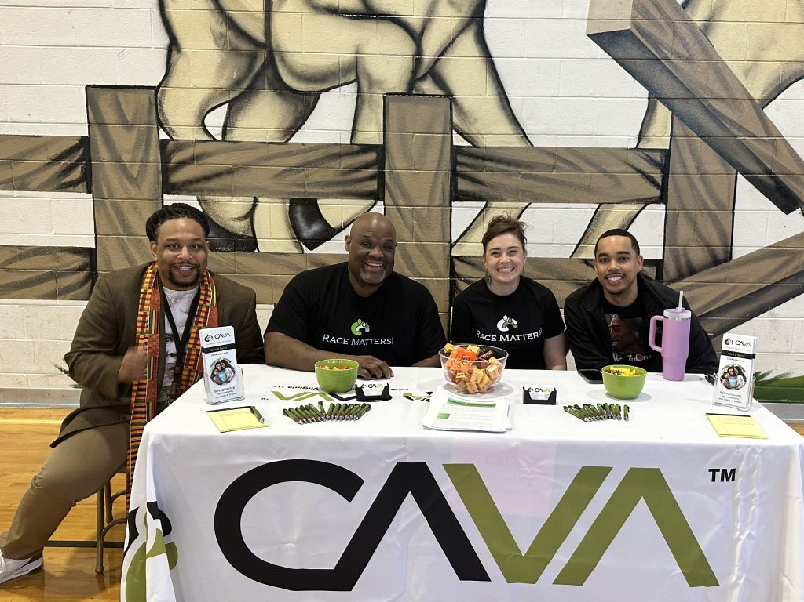

ACPS and CAVA
To support ACPS Anti-Racist policy “to eliminate all forms of racism from the Division in conjunction with related board policies”.
To create space for stronger cross racial authentic connections and conversations among students, parents, teachers, and school administrators.
To augment ACPS initiative to increase equitable outcomes for students of color.
To manifest a racialized lingo and lens for the ACPS community and division.
Notes:
Counseling Alliance of Virginia (CAVA) and Albemarle County Public Schools have partnered for the past 3 years
Our Vision: Our learners are engaged in authentic, challenging, and relevant learning experiences, becoming lifelong contributors and leaders in our dynamic and diverse society.
Our Mission: Working together as a team, we will end the predictive value of race, class, gender, and special capacities for our children's success through high-quality teaching and learning for all. We seek to build relationships with families and communities to ensure that every student succeeds. We will know every student.
Our Values: ? Equity: We will provide every student with the level of support necessary to thrive. ? Excellence: We will mitigate barriers and provide opportunities for every student to be academically successful. ? Family and Community: We will engage with and share the responsibility for student success with families and community partners. ? Wellness: We will support the physical and emotional health of our students and staff.

Slide 4
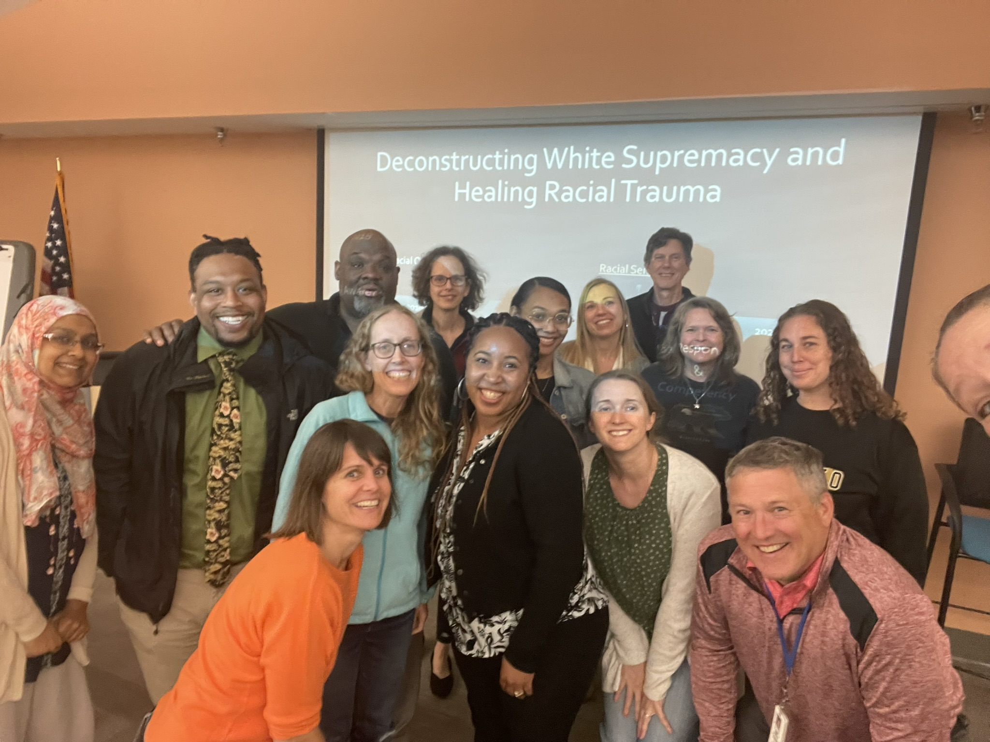
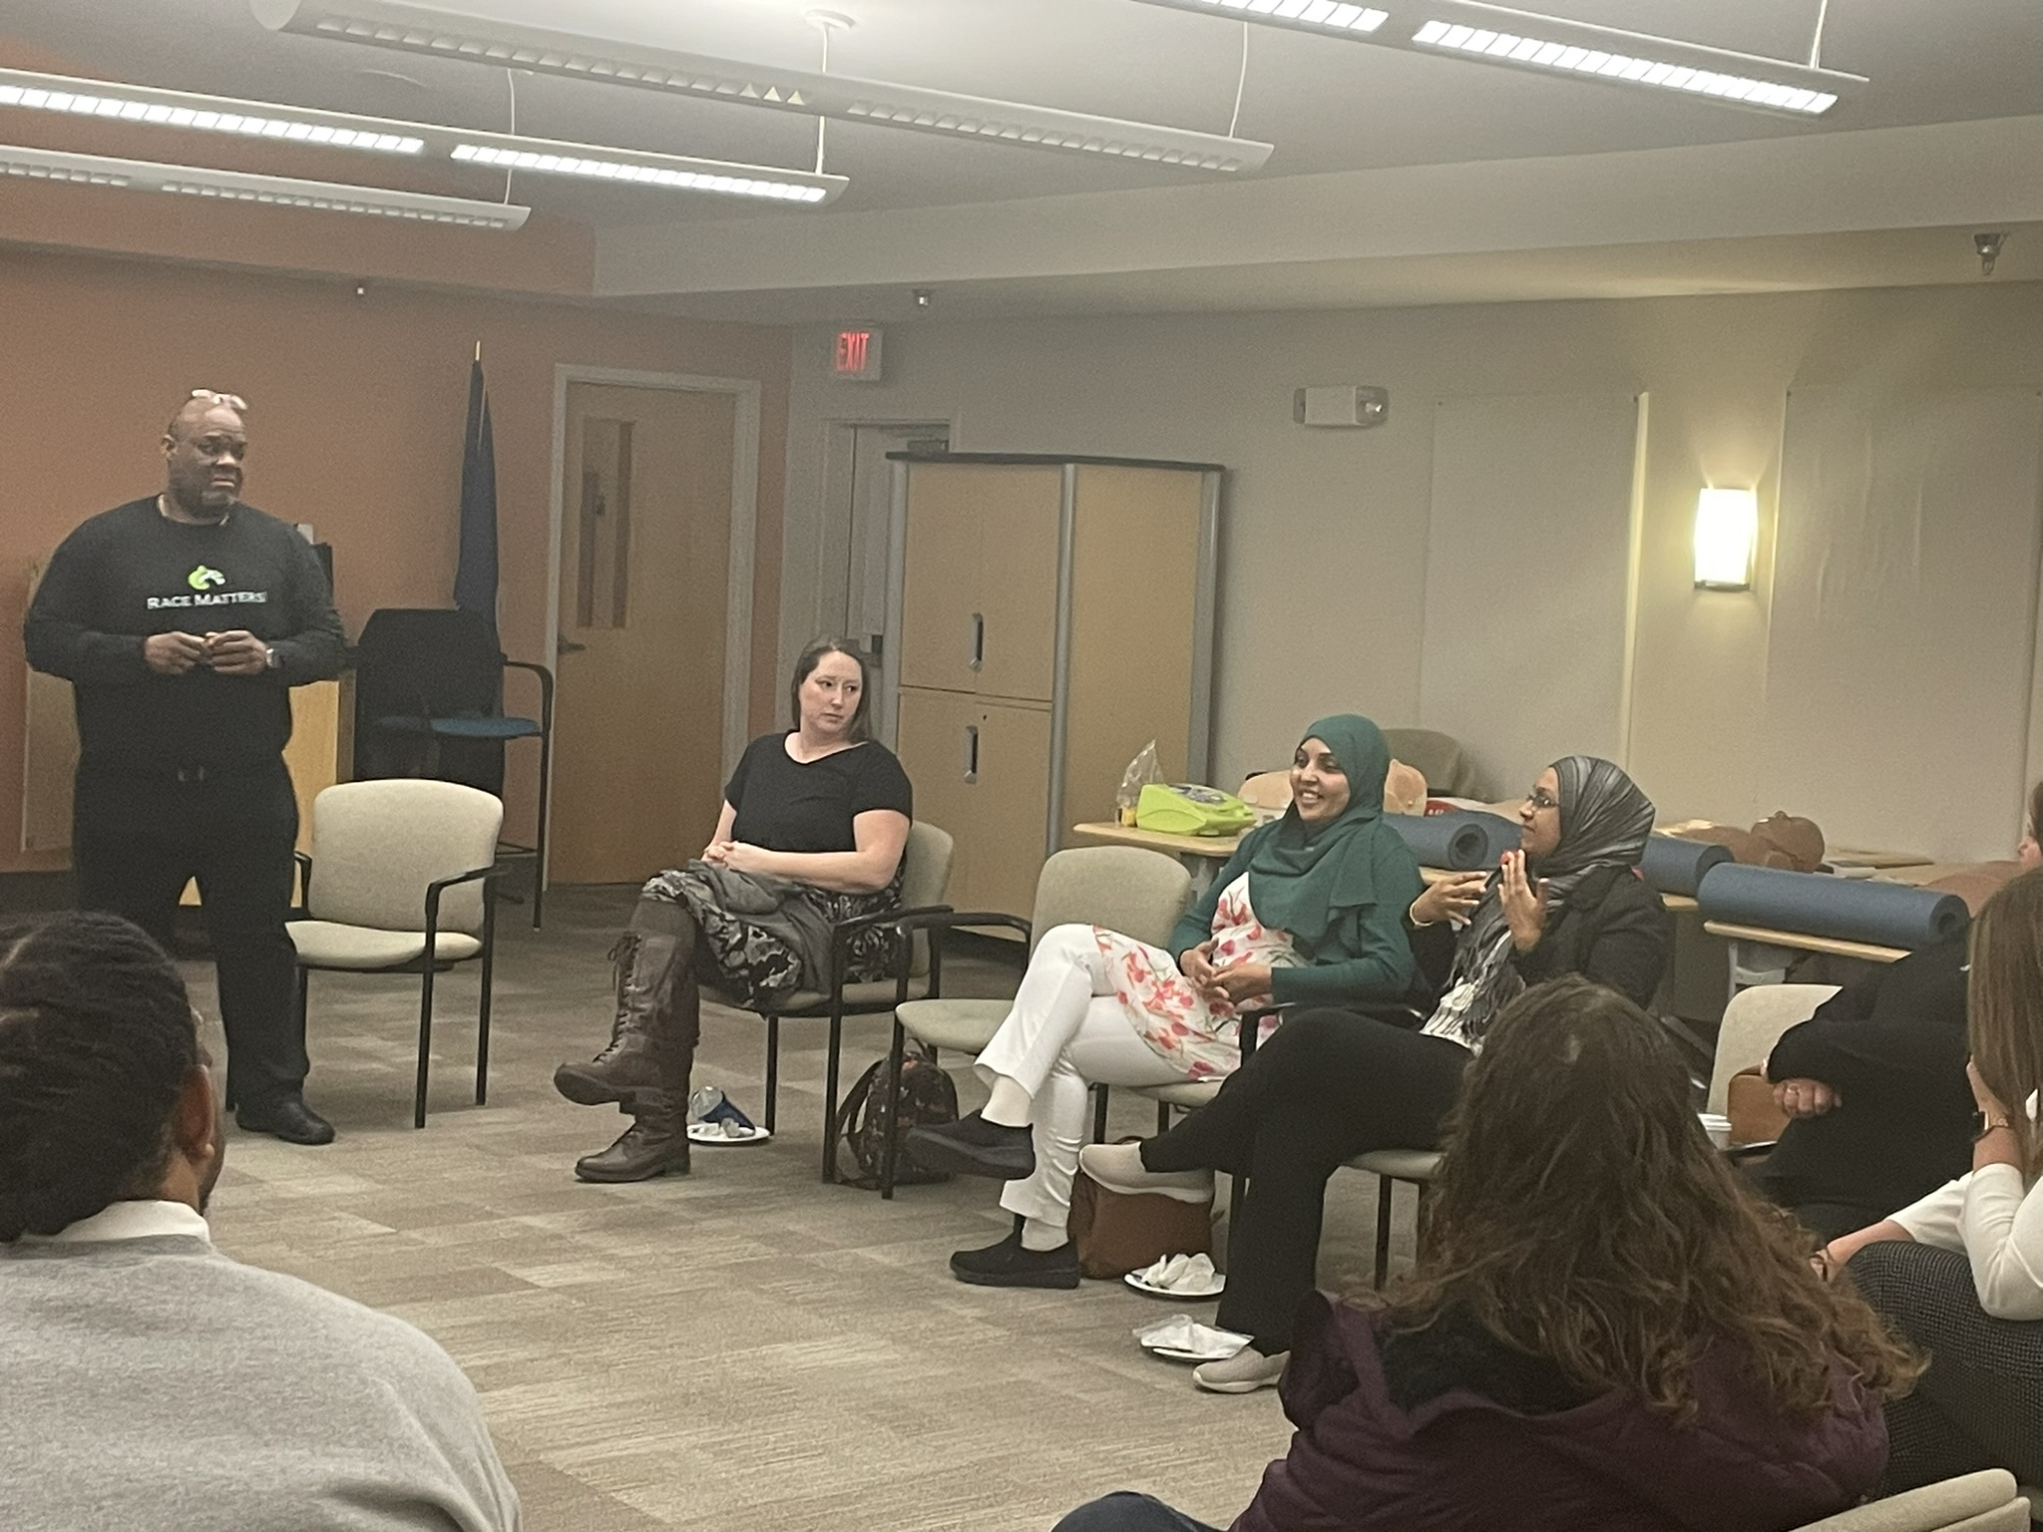
Scope of Work
“Consultation with Agnor Hurt and PTO”
Race Matters in Schools Cohorts I-III
– Pending IV
Leadership Cabinet Session
3 Professional Development Days
Albemarle County Family Council
Student Senate– Consultation Day
Equity Chang Team - Creating Space for Race Training

Slide 5
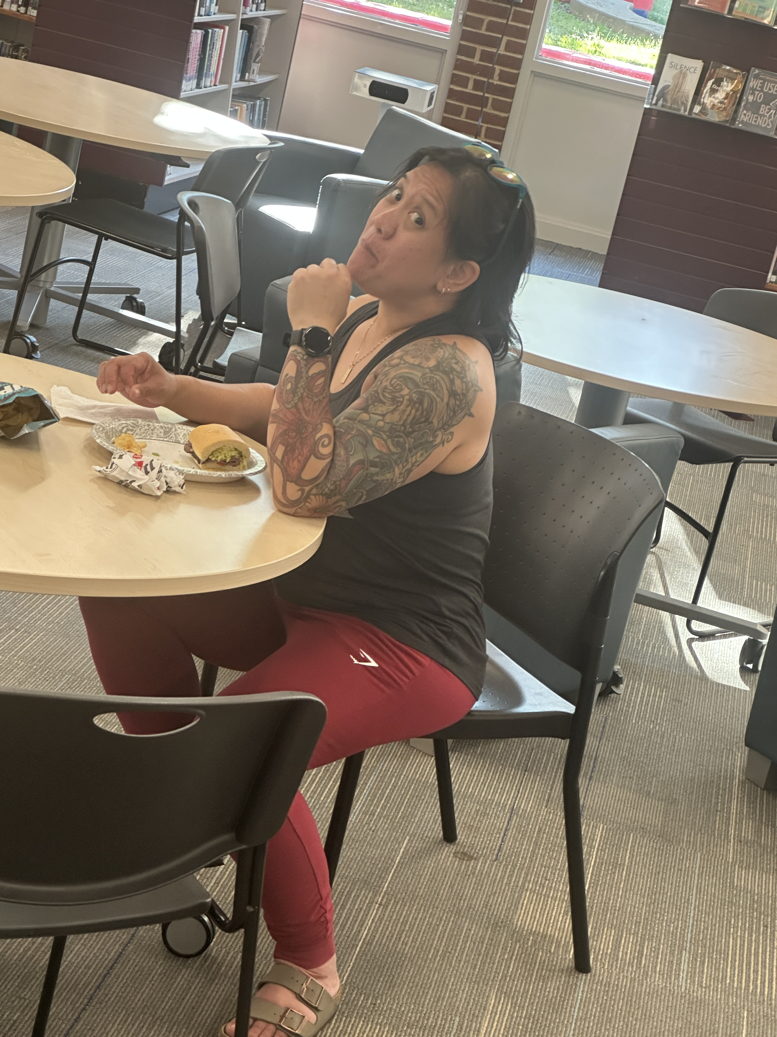

Scope of Work
Diversity Resource Teachers Training on Racial Awareness and Sensitivity
Mental Health Support: Turning Point Event at WAHS
Reviewed and analyzed Bellwether Report Findings
Reviewed and analyzed ACPS Anti-Racism Policy

Slide 6

Race Matters: What we heard…

Slide 7
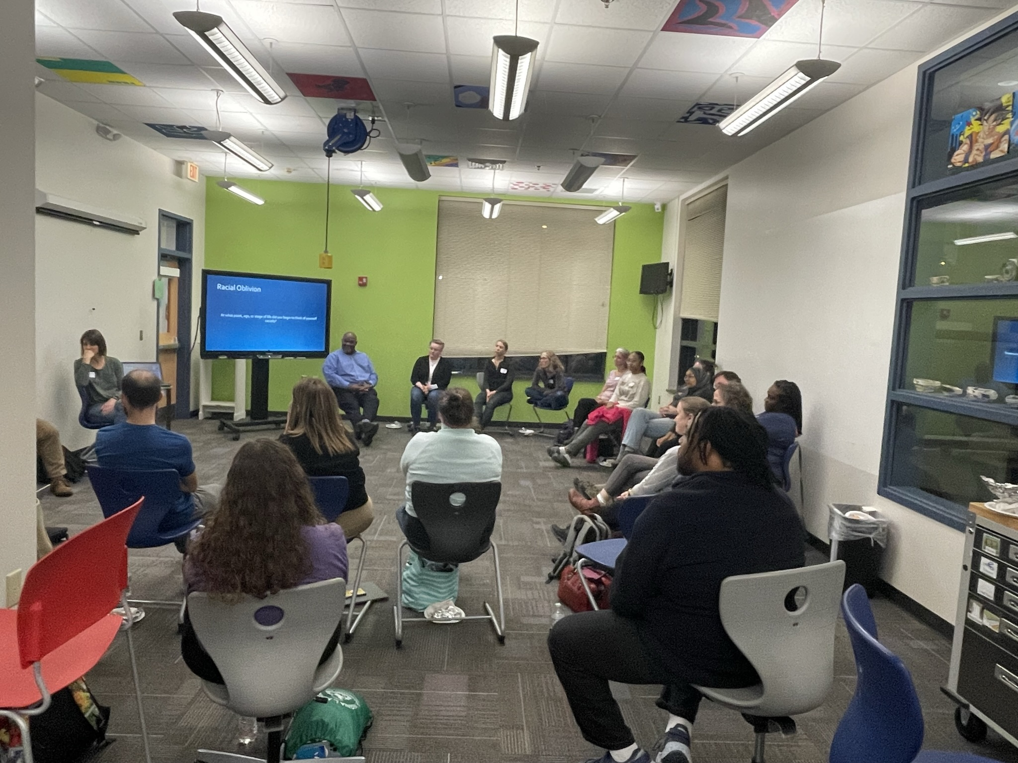
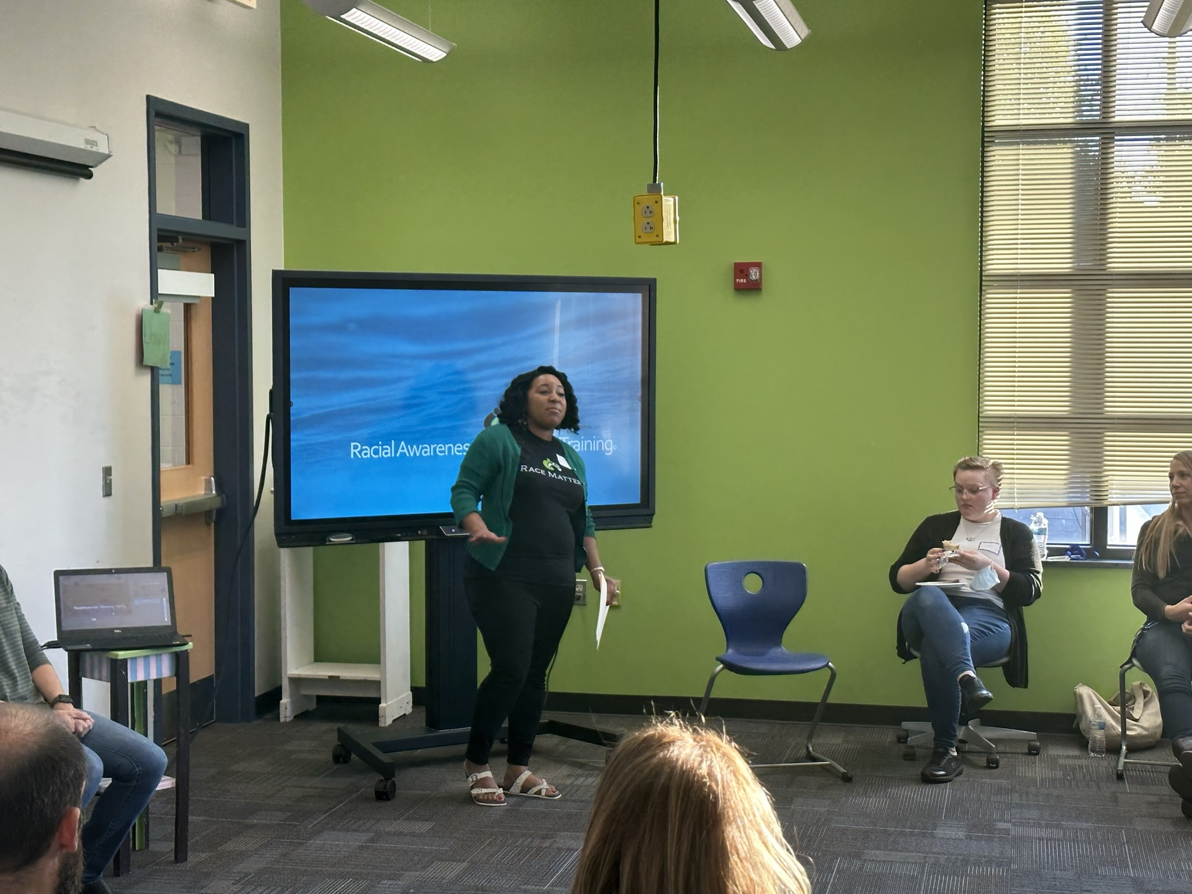
Race Matters: Recommendations for 2026-2027
Race Matters in Schools - Cohort IV
Racial Awareness and Sensitivity Training (RAS) for
ACPS School Board Members
RAS Trainings for - Student Senate and Equity Change Teams
Standing Racial Awareness and Sensitivity Core Team

Slide 8
Race Matters: Overall impact….
SY 2026- ????
Immediate
Intermediate
Longterm
Increase in Positive Cross Racial Relationships – self confidence
Equitable Access to resources and learning
Decrease in hoarding opportunities and sabotaging other races
Protection from devaluation and dehumanization – Objectification
Normalizing Overinflated ego and sense of self - Exceptionalism
Fair and equitable educational, instructional, and disciplinary outcomes for “ALL” students.
Increase family and school interactions
Increase in racial and cultural humility for students and teachers in the privileged position.
Promote a culture of inclusion and decenter Anglocentrism
Teachers and Counselors racial stereotypes will be challenged and Black and Students of color will be encouraged and supported in their educational aptitude and goals,
Increase in black students and students of color feeling seen and validated able to achieve their goals and aspirations
Increase in humanity in healthcare, education, judicial and financial realms
Asserting racial frame of liberty and justice for all would become congruent through action vs words alone.
Equitable treatment for all related to funding, housing, education, and liberty
Increase in humanity
Increase in a true and just democracy which flourishes our economy and the welfare state of this country.

Slide 9
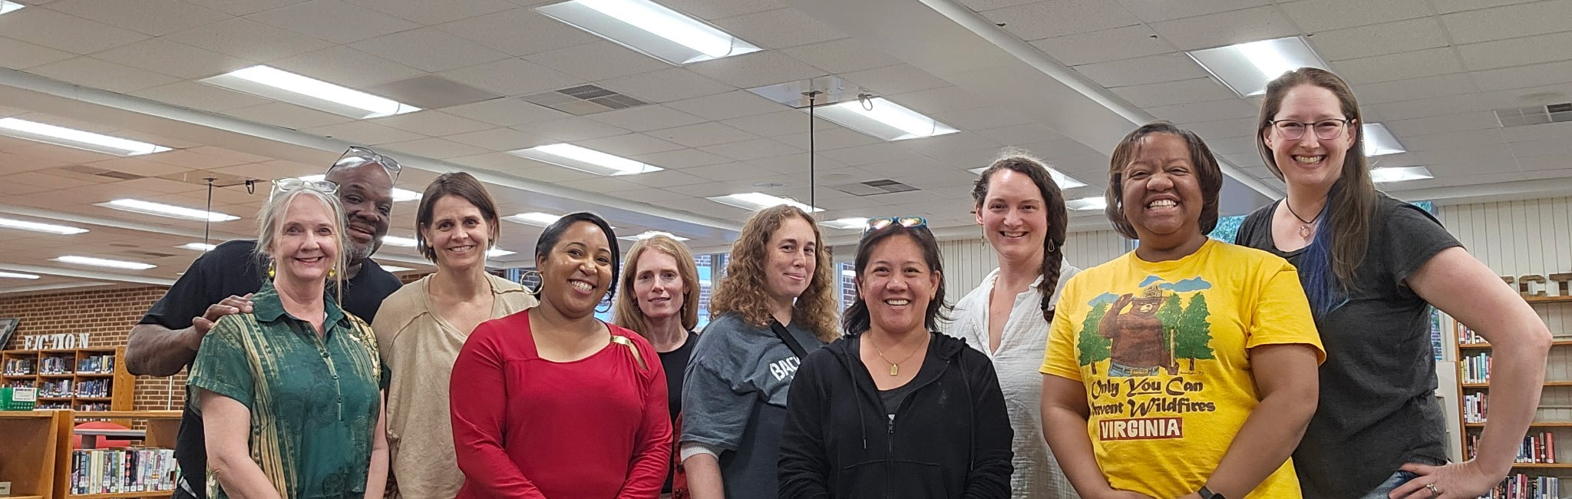
Race Matters: In Closing……
SY 2026-2027
Reach one Teach One!!
We all need and deserve to grow!!

Slide 10
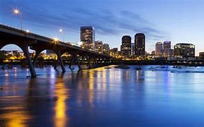

Gene Cash Jr. LCSW, LISW-S
CEO/Owner
LaTasha Edwards MS, QMHP
Race Matters Trainer
Counseling Alliance of Virginia – Race Matters Consulting Group
Beyond…
CAVA East
www.cavahelps.com
CAVA West
2924 Emerywood Pkwy – Ste 200
Richmond, VA 23294
804.346.5165
335 Greenbrier Dr – Ste 206
Charlottesville, VA 22901
434.220.0333

Slide 11
Key and Meaningful Reflections & Takeaways
Skepticism and Doubt
Courage – Will and Skill to be in Relationship
P.O.T.T.’S
Need and Desire for Connection – Being In Relationship
Undertow of White Supremacy Ideology-Framing
Breaking Oblivion
Validation
Desire for More and to do No Harm in effort to help Heal!

